Slide 1
Methods for Dummies Overview and Introduction
Rachel Bedder and Benjamin Chew
Wellcome Trust Centre for Neuroimaging, UCL
Max Planck UCL Centre for Computational Psychiatry and Ageing Research

Slide 2
Overview
What is MfD?
How to prepare your presentation
Where to find information and help

Slide 3
What is Methods for Dummies
Aim of MfD: to provide a basic introduction to human brain imaging analysis methods, focusing on fMRI and M/EEG
Wednesdays 1300-1400 hrs in 1st Floor Boardroom
Each talk will be given by two presenters and lasts about 30 min + 15 minutes for questions. Generally it should introduce the relevant theory and be followed by a demo using SPM12 interface.

Slide 4
How to Prepare
Read the Presenter’s Guide
Prepare the slides with your Partner
Meet with your Expert
Remember your audience are not experts

Slide 5
Where to find information
Go to the MfD homepage → Resources
http://www.fil.ion.ucl.ac.uk/mfd/
Previous years’ slides
Human Brain Function Textbook (online)
SPM course slides
Cambridge CBU homepage (Rik Henson’s slides)
Methods Group Experts
Monday Methods Meetings (4th floor FIL, 12.30)
SPM email list

Slide 6
Brief course overview
We will cover principle concepts involved in analysing functional neuroimaging data with a focus on SPM

Slide 7
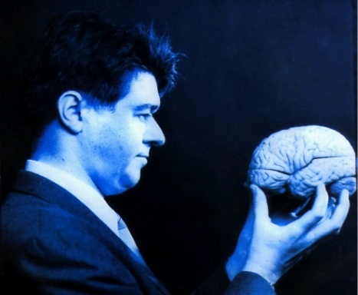
SPM
Statistical Parametric Mapping
Invented at the FIL
A software package designed for the analysis of brain imaging data in fMRI, PET, SPECT, EEG & MEG
It runs in MATLAB… just type SPM at the prompt and all will be revealed
The SPM website has a manual and datasets available for playing around with

Slide 8
SPM
MATLAB (UCL Software):
https://swdb.ucl.ac.uk/
SPM12:
http://www.fil.ion.ucl.ac.uk/spm/software/

Slide 9
fMRI overview

Slide 10
fMRI overview

Slide 11
fMRI overview
PREPROCESSING
Notes:
Remove movement artefacts from the timeseries, bring functional and anatomical images in line with one another

Slide 12
fMRI overview
GENERAL LINEAR MODEL
Notes:
Once you have carried out your pre-processing you can specify your design and data
The design matrix is simply a mathematical description of your experiment based on the General Linear Model, and is used to quantify the effects of the experimental variable on the BOLD signal
E.g. ‘visual stimulus on = 1’ ‘visual stimulus off = 0’
GLM describes the data at each voxel: mass univariate approach
Takes into account Experimental and confounding effects…
and residual variability
GLM used in combination with a temporal convolution model

Slide 13
fMRI overview
STATISTICAL INFERENCE

Slide 14
Other techniques
Notes:
GLM describes the data at each voxel: mass univariate approach
Takes into account Experimental and confounding effects…
and residual variability
GLM used in combination with a temporal convolution model
Once you have carried out your pre-processing you can specify your design and data
The design matrix is simply a mathematical description of your experiment
E.g. ‘visual stimulus on = 1’ ‘visual stimulus off = 0’

Slide 15
Other techniques

Slide 16
Other techniques

Slide 17
Final points
Course only works if everyone chips in
E-mail ASAP to confirm your allocations
Register online: bit.ly/2wuNYbe
Some of the topics seem hard but please don’t worry
“I have no idea what 90% of these words mean” (Anonymous, 2017)
Rules for swaps:
There will be a reserve list – please email

Slide 18
Optional Topics
Computational Modeling of Behaviour
Reinforcement Learning

